Slide 1
Recent Developments
15min

Slide 2
Recent Developments
Machine learning in Causal Inference
Regression adjustment
Beyond Average Treatment Effect, a.k.a. Effect Heterogeneity
Bayesian A/B Testing
…

Slide 3

Regression adjustment and Variance Reduction
$Δ$ is our normal treatment effect estimate. Find another $Δ^{∗}$ such that
$E\left(Δ^{∗}\right)=E(Δ)$, so both are estimating the same Average Treatment Effect
$Var\left(Δ^{∗}\right)<Var(Δ)$, so test based on $Δ^{∗}$ is more sensitive

Slide 4
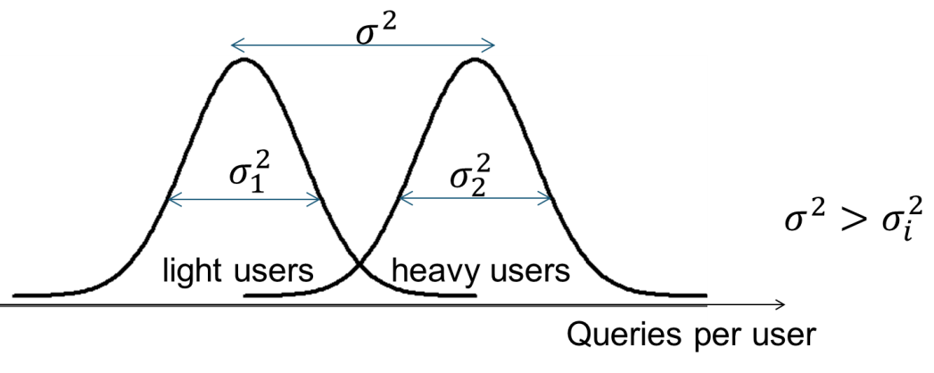
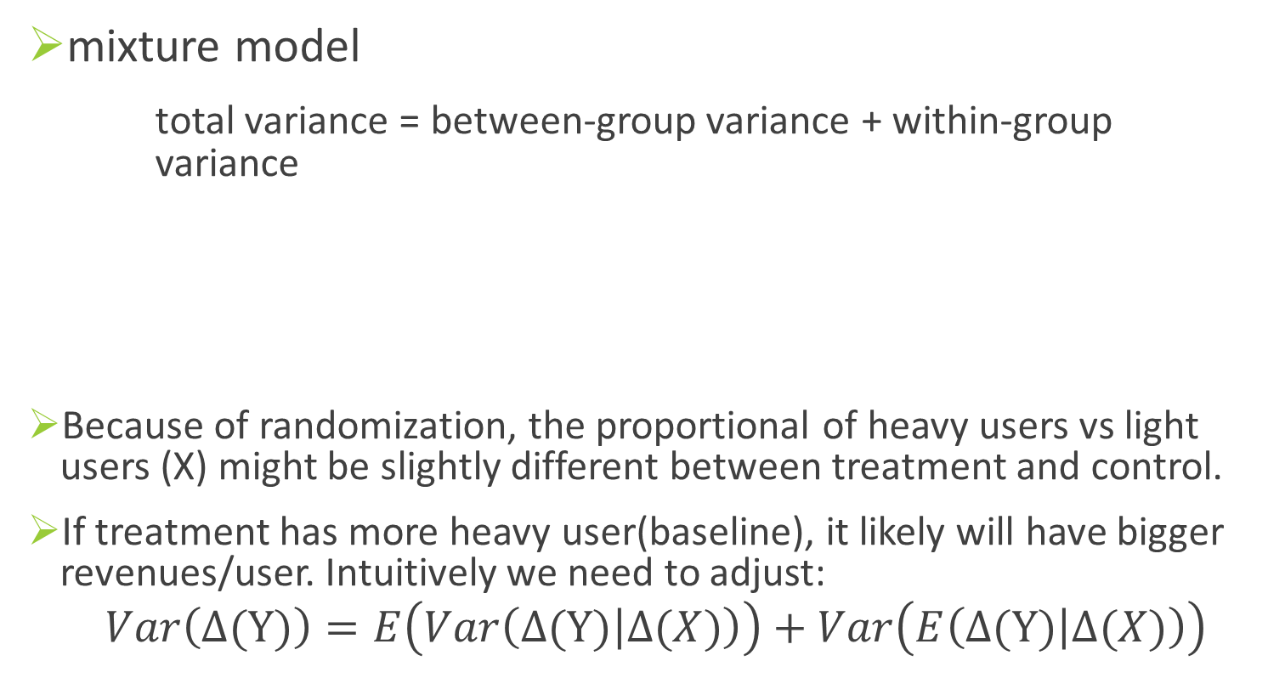
Motivation: baseline adjustment
mixture model
total variance = between-group variance + within-group variance
Because of randomization, the proportional of heavy users vs light users (X) might be slightly different between treatment and control.
If treatment has more heavy user(baseline), it likely will have bigger revenues/user. Intuitively we need to adjust:
$$Var\left(Δ(Y)\right)=E\left(Var\left(Δ(Y) | Δ(X)\right)\right)+Var\left(E\left(Δ(Y) | Δ(X)\right)\right)$$
Variance explained by X

Slide 5

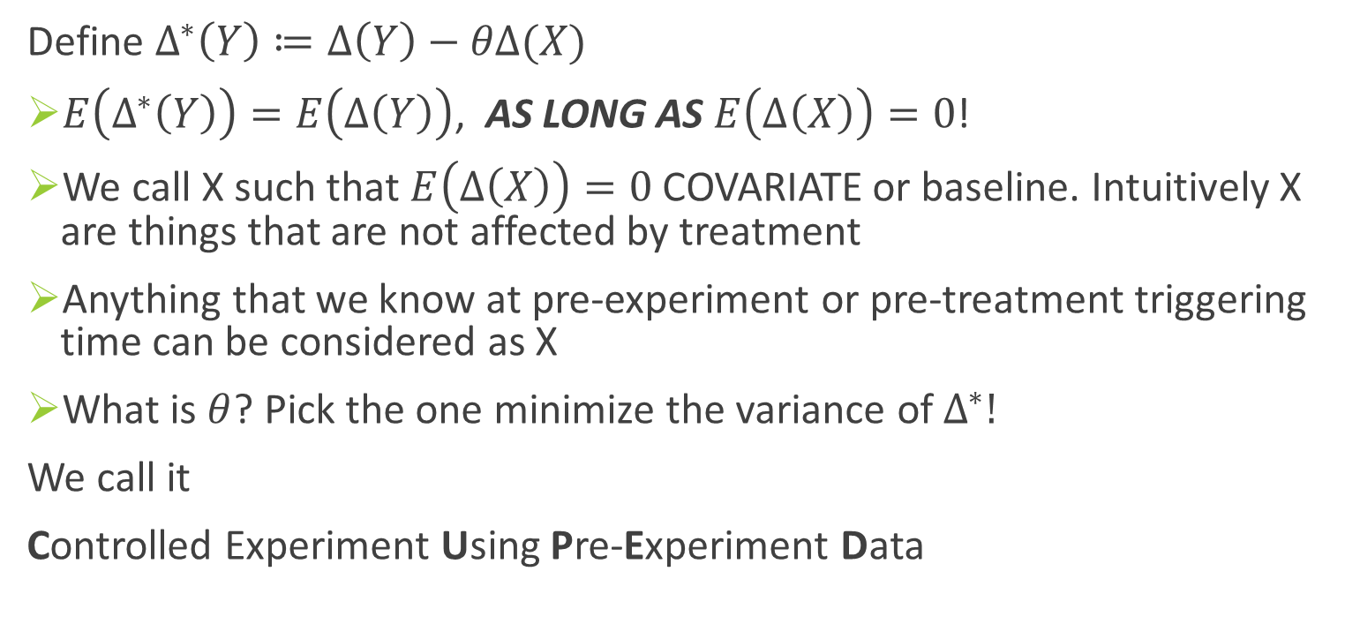
CUPED (WSDM 2013)
Define $Δ^{∗}\left(Y\right)≔Δ\left(Y\right)−θΔ(X)$
$E\left(Δ^{∗}\left(Y\right)\right)=E\left(Δ\left(Y\right)\right)$, AS LONG AS $E\left(Δ\left(X\right)\right)=0$!
We call X such that $E\left(Δ\left(X\right)\right)=0$ COVARIATE or baseline. Intuitively X are things that are not affected by treatment
Anything that we know at pre-experiment or pre-treatment triggering time can be considered as X
What is $θ$? Pick the one minimize the variance of $Δ^{∗}!$
We call it
Controlled Experiment Using Pre-Experiment Data
Notes:
There is no data snooping by picking theta based on data. Why? Thata depends on covariance matrix, and covariance estimator is independent of the delta estimator

Slide 6
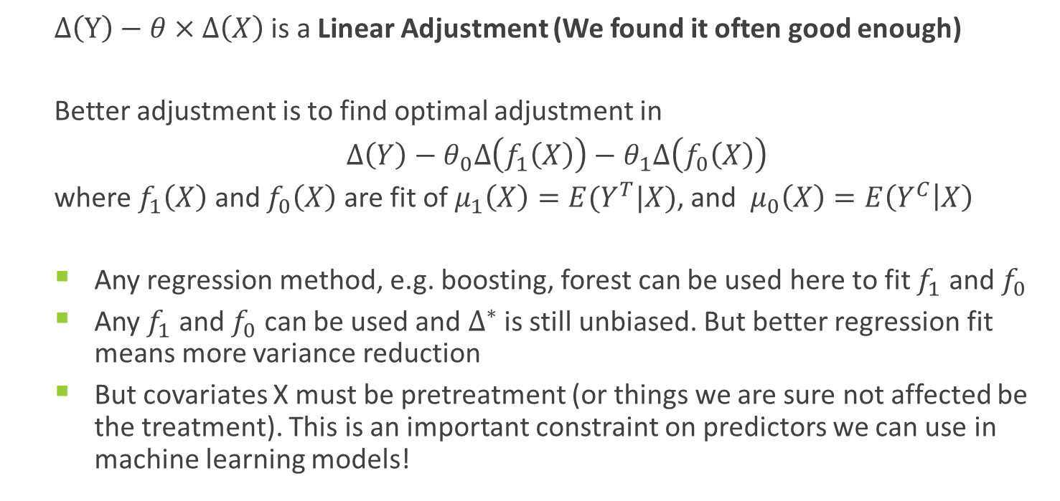
Extension with modern Machine Learning
$Δ\left(Y\right)−θ×Δ\left(X\right)$ is a Linear Adjustment (We found it often good enough)
Better adjustment is to find optimal adjustment in
$Δ\left(Y\right)−θ_{0}Δ\left(f_{1}\left(X\right)\right)−θ_{1}Δ\left(f_{0}\left(X\right)\right)$
where $f_{1}\left(X\right)$ and $f_{0}\left(X\right)$ are fit of $μ_{1}\left(X\right)=E(Y^{T}|X)$, and $μ_{0}\left(X\right)=E\left(Y^{C} | X\right)$
Any regression method, e.g. boosting, forest can be used here to fit $f_{1}$ and $f_{0}$
Any $f_{1}$ and $f_{0}$ can be used and $Δ^{∗}$ is still unbiased. But better regression fit means more variance reduction
But covariates X must be pretreatment (or things we are sure not affected be the treatment). This is an important constraint on predictors we can use in machine learning models!

Slide 7
Beyond Average Treatment Effect
When we say “treatment effect” most cases we refer to Population Average Treatment Effect (ATE or PATE)
We know treatment effect differs from unit to unit
A feature might not be popular in some markets -> improvement
A feature might be broken on one browser -> bug
There could be many micro-structure in subpopulations, where treatment effect varies, or even flip sign!
Heterogeneous Treatment Effect (HTE): Hot topic in Economics/Policy Evaluation, Personalized/precise Treatment/Drug, etc.

Slide 8
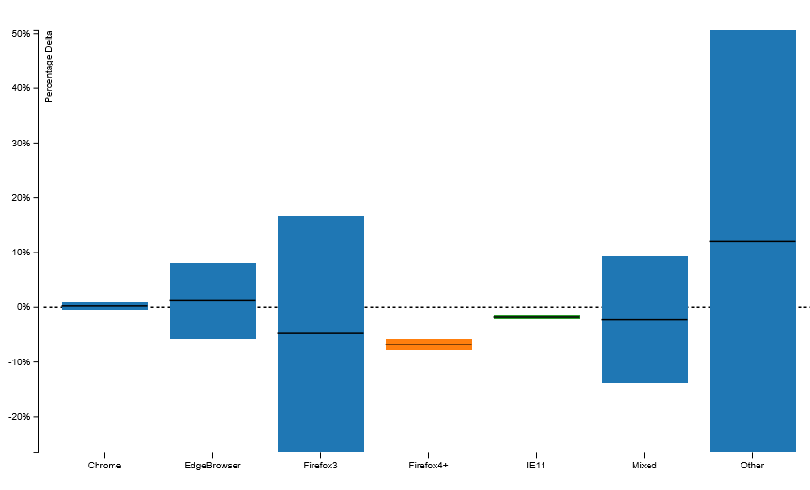
Browser difference

Slide 9
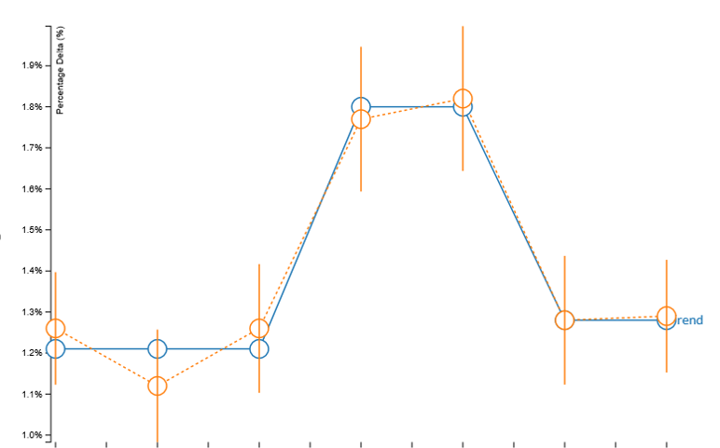
Weekend vs weekday

Slide 10
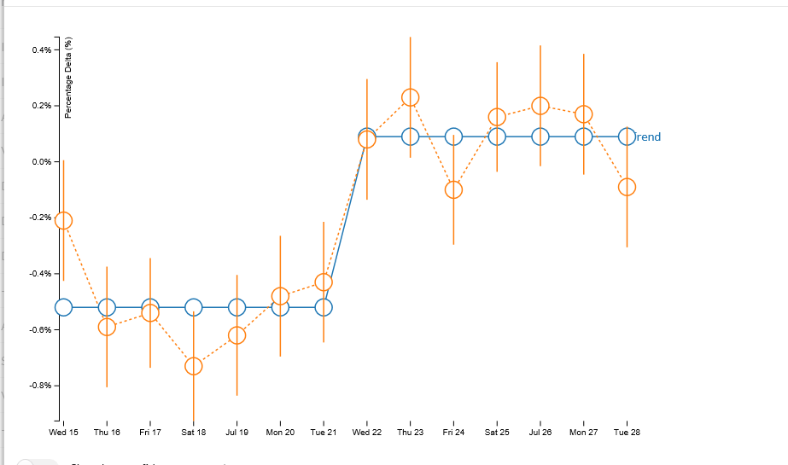
Shift

Slide 11
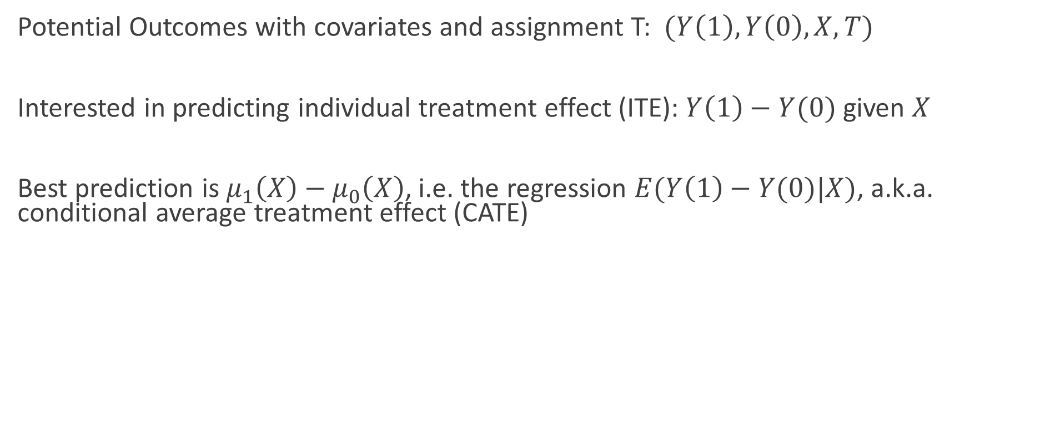
CATE: Conditional Average Treatment Effect
Potential Outcomes with covariates and assignment T: $(Y\left(1\right), Y\left(0\right), X, T)$
Interested in predicting individual treatment effect (ITE): $Y\left(1\right)−Y(0)$ given $X$
Best prediction is $μ_{1}\left(X\right)−μ_{0}\left(X\right)$, i.e. the regression $E(Y\left(1\right)−Y(0)|X)$, a.k.a. conditional average treatment effect (CATE)

Slide 12
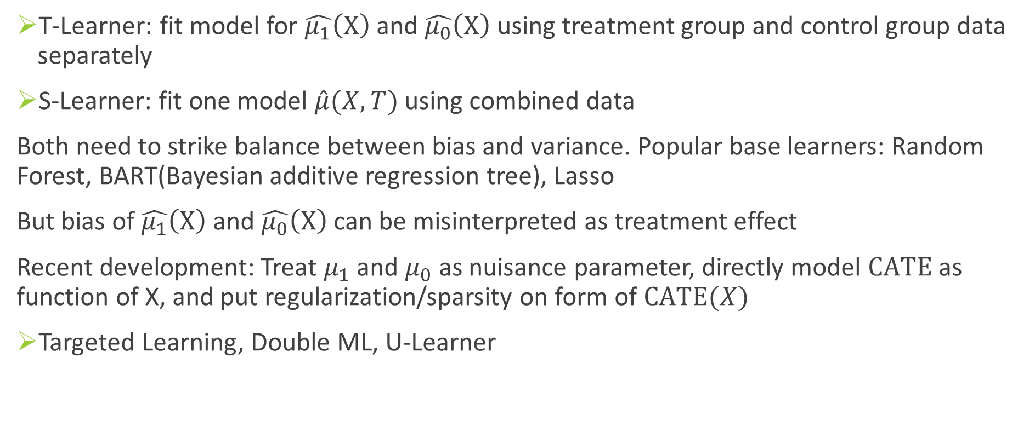
Meta Learners
T-Learner: fit model for $\hat{μ_{1}}\left(X\right)$ and $\hat{μ_{0}}\left(X\right)$ using treatment group and control group data separately
S-Learner: fit one model $\hat{μ}(X,T)$ using combined data
Both need to strike balance between bias and variance. Popular base learners: Random Forest, BART(Bayesian additive regression tree), Lasso
But bias of $\hat{μ_{1}}\left(X\right)$ and $\hat{μ_{0}}\left(X\right)$ can be misinterpreted as treatment effect
Recent development: Treat $μ_{1}$ and $μ_{0}$ as nuisance parameter, directly model $CATE$ as function of X, and put regularization/sparsity on form of $CATE(X)$
Targeted Learning, Double ML, U-Learner

Slide 13
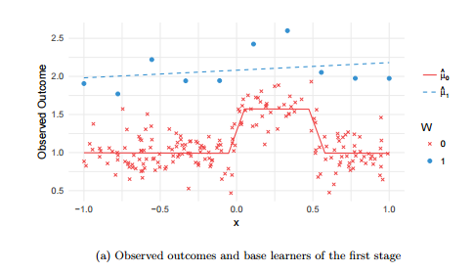
Overfit or not overfit?
Kunzel et al., 2017. Figure 1.a

Slide 14
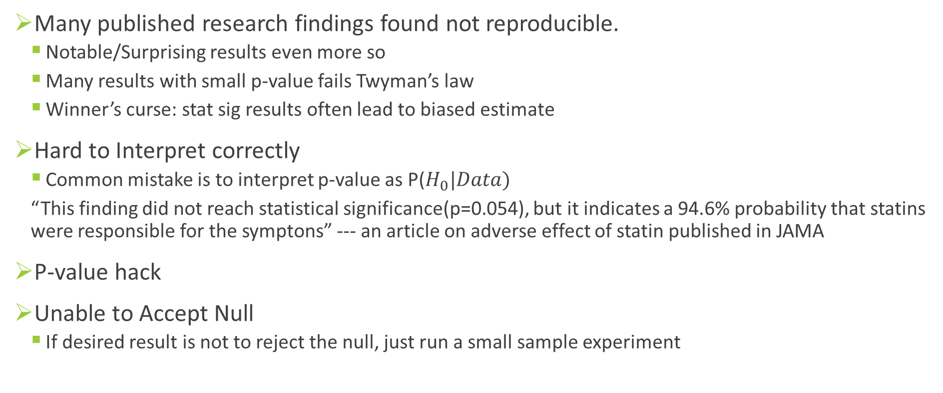
Bayesian A/B Tests
Many published research findings found not reproducible.
Notable/Surprising results even more so
Many results with small p-value fails Twyman’s law
Winner’s curse: stat sig results often lead to biased estimate
Hard to Interpret correctly
Common mistake is to interpret p-value as P($H_{0}|Data)$
“This finding did not reach statistical significance(p=0.054), but it indicates a 94.6% probability that statins were responsible for the symptons” --- an article on adverse effect of statin published in JAMA
P-value hack
Unable to Accept Null
If desired result is not to reject the null, just run a small sample experiment

Slide 15
P(H0|Data), not P(Data|H0)
P(H1|Data) is the Bayesian posterior belief of the alternative hypothesis, it is closely related to the concept of FDR (False discovery Rate)
P(H1|Data) = 1- P(H0|Data) represents the confidence of a correct ship decision
P(H0|Data) and P(H1|Data) are auto-adjusted for multiple testing adjustment if metrics movements are independent (why should you care about hundreds of other unrelated tests?)

Slide 16
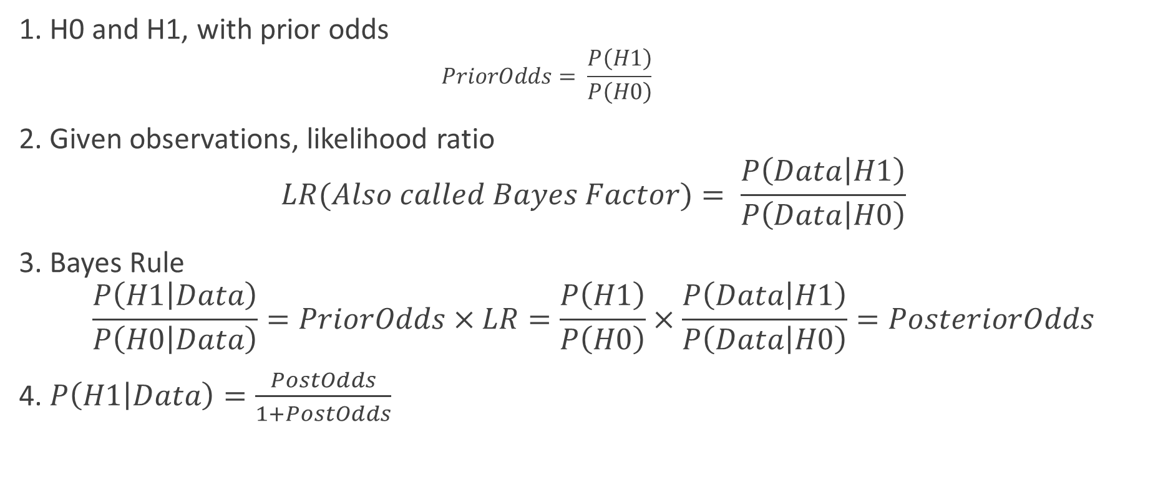
Bayesian Two Sample Hypothesis Testing: full symmetry!
1. H0 and H1, with prior odds
$$PriorOdds= \frac{P\left(H1\right)}{P\left(H0\right)}$$
2. Given observations, likelihood ratio
$$LR(Also called Bayes Factor)= \frac{P\left(Data | H1\right)}{P\left(Data | H0\right)}$$
3. Bayes Rule
$$\frac{P\left(H1 | Data\right)}{P\left(H0 | Data\right)}=PriorOdds×LR=\frac{P\left(H1\right)}{P\left(H0\right)}×\frac{P\left(Data | H1\right)}{P\left(Data | H0\right)}=PosteriorOdds$$
4. $P\left(H1 | Data\right)=\frac{PostOdds}{1+PostOdds}$

Slide 17
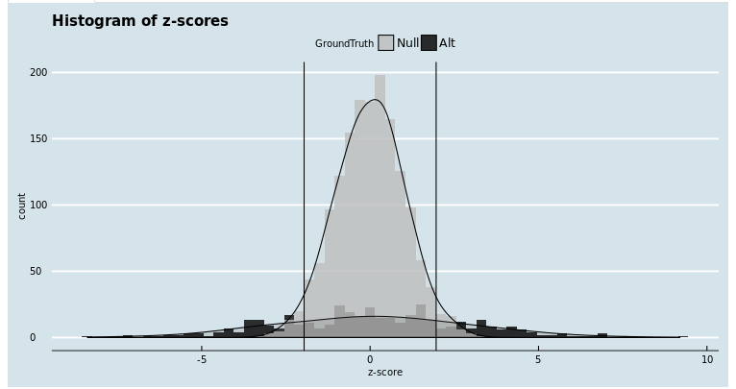
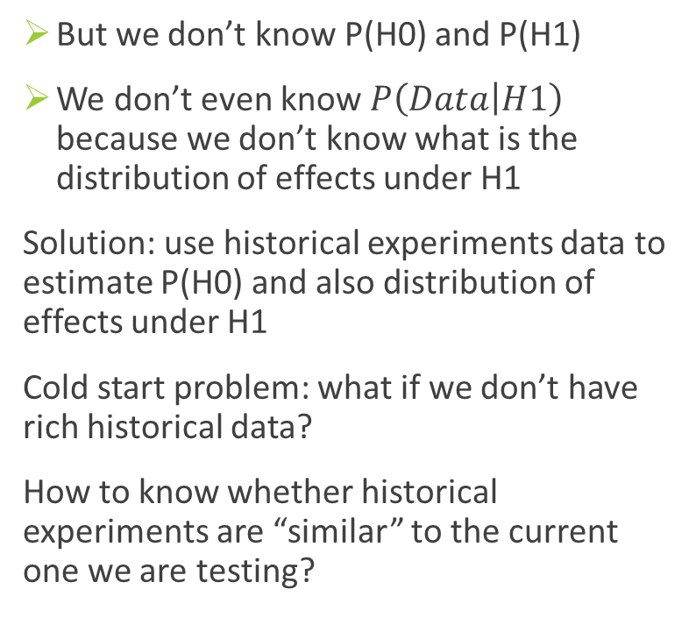
Using Rich Historical Experiment Data
But we don’t know P(H0) and P(H1)
We don’t even know $P\left(Data | H1\right)$ because we don’t know what is the distribution of effects under H1
Solution: use historical experiments data to estimate P(H0) and also distribution of effects under H1
Cold start problem: what if we don’t have rich historical data?
How to know whether historical experiments are “similar” to the current one we are testing?

Slide 18
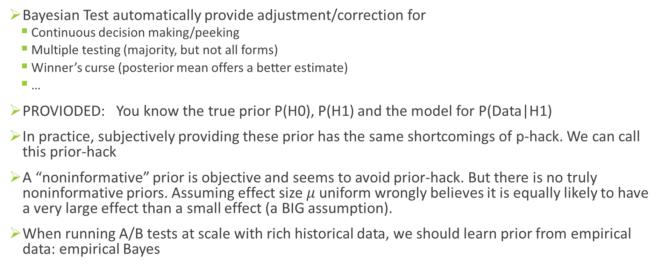
Remarks on Bayesian Test
Bayesian Test automatically provide adjustment/correction for
Continuous decision making/peeking
Multiple testing (majority, but not all forms)
Winner’s curse (posterior mean offers a better estimate)
…
PROVIODED: You know the true prior P(H0), P(H1) and the model for P(Data|H1)
In practice, subjectively providing these prior has the same shortcomings of p-hack. We can call this prior-hack
A “noninformative” prior is objective and seems to avoid prior-hack. But there is no truly noninformative priors. Assuming effect size $μ$ uniform wrongly believes it is equally likely to have a very large effect than a small effect (a BIG assumption).
When running A/B tests at scale with rich historical data, we should learn prior from empirical data: empirical Bayes
Notes:
In practice key metrics movements are correlated, so some adjustment is still needed. But the number of highly correlated metrics are much smaller than the total number of metrics people compute.
And the adjustment can be positive or negative: high confidence of User satisfaction increase reinforce the confidence of revenue increase. This is very different from p-value multiple testing adjustment, where more tests always ask for lower p-value threshold

Slide 19
References
Deng et al., 2013: Improving the Sensitivity of Online Controlled Experiments by Utilizing Pre-Experiment Data
Peysakhovich and Eckles, 2017: Learning causal effects from many randomized experiments using regularized instrumental variables
Kharitonov et al., 2017: Learning sensitive combinations of a/b test metrics
Deng et al., 2017 : Continuous monitoring of A/B tests without pain: Optional stopping in Bayesian testing
Deng, 2015: Objective Bayesian two sample hypothesis testing for online controlled experiments
Wager and Athey, 2015: Estimation and Inference of Heterogeneous Treatment Effects using Random Forests
Tian et al., 2012:A Simple Method for Detecting Interactions between a Treatment and a Large Number of Covariates
Deng et al., 2017: Concise Summarization of Heterogeneous Treatment Effect Using Total Variation Regularized Regression
Tansey et al., 2017: Interpretable Low-Dimensional Regression via Data-Adaptive Smoothing
Zhao et al., 2017: Selective inference for effect modification via the lasso
Kunzel et al., 2017: Meta-learners for Estimating Heterogeneous Treatment Effects using Machine Learning

Slide 20
Questions?
http://exp-platform.com

Slide 21
Appendix

Slide 22
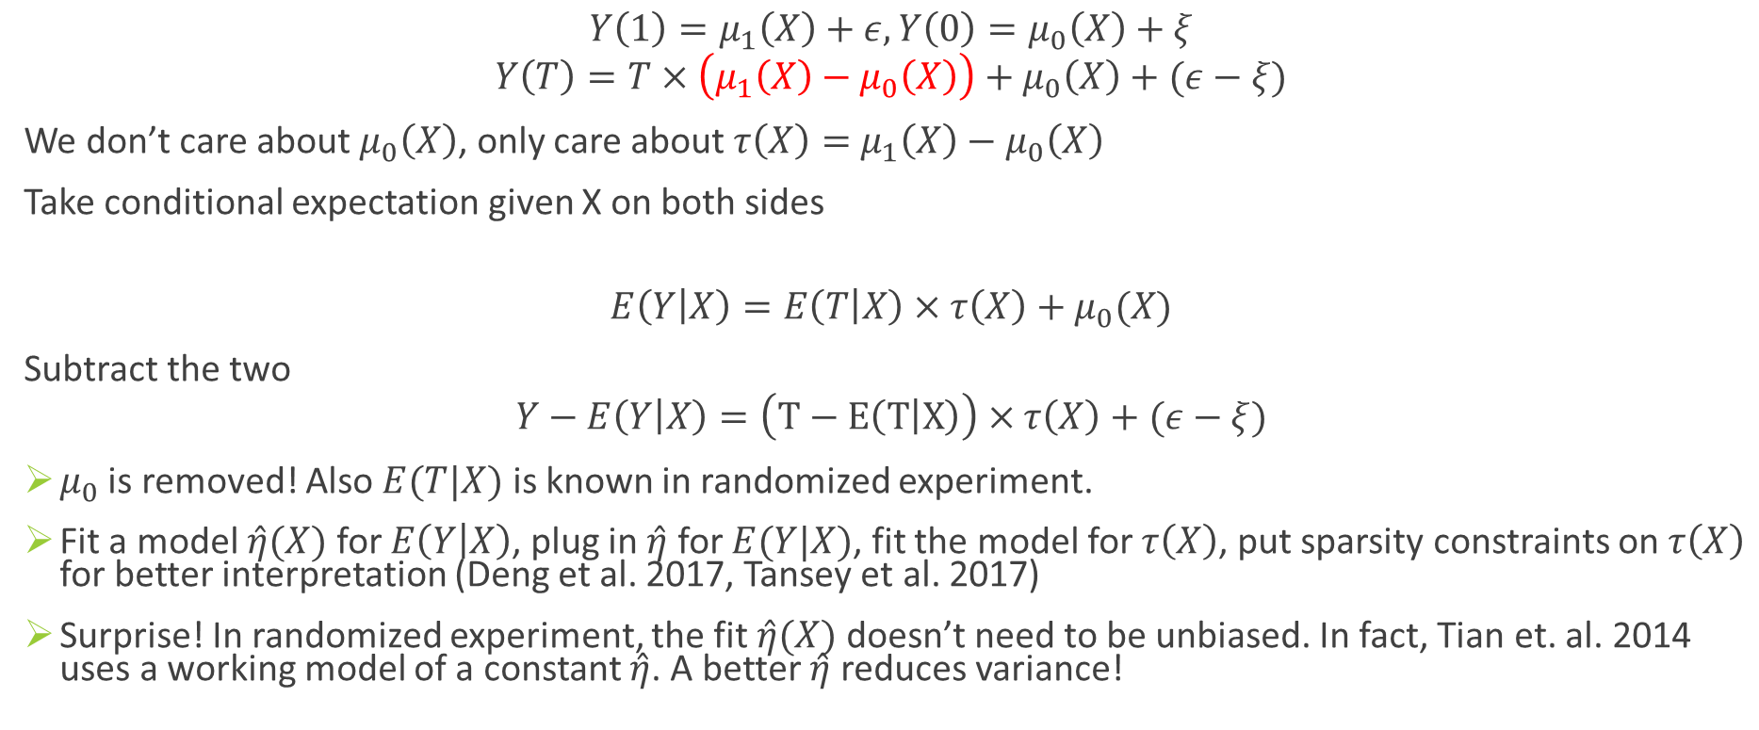
Targeted Learning/Remove Nuisance Parameter
$$Y\left(1\right)=μ_{1}\left(X\right)+ε, Y\left(0\right)=μ_{0}\left(X\right)+ξ$$
$$Y\left(T\right)=T×\left(μ_{1}\left(X\right)−μ_{0}\left(X\right)\right)+μ_{0}\left(X\right)+(ε−ξ)$$
We don’t care about $μ_{0}\left(X\right)$, only care about $τ\left(X\right)=$ $μ_{1}\left(X\right)−μ_{0}\left(X\right)$
Take conditional expectation given X on both sides
$$E\left(Y | X\right)=E\left(T | X\right)×τ\left(X\right)+μ_{0}(X)$$
Subtract the two
$$Y−E\left(Y | X\right)=\left(T−E\left(T | X\right)\right)×τ\left(X\right)+(ε−ξ)$$
$μ_{0}$ is removed! Also $E(T|X)$ is known in randomized experiment.
Fit a model $\hat{η}(X)$ for $E\left(Y | X\right)$, plug in $\hat{η}$ for $E(Y|X)$, fit the model for $τ\left(X\right)$, put sparsity constraints on $τ\left(X\right)$ for better interpretation (Deng et al. 2017, Tansey et al. 2017)
Surprise! In randomized experiment, the fit $\hat{η}(X)$ doesn’t need to be unbiased. In fact, Tian et. al. 2014 uses a working model of a constant $\hat{η}$. A better $\hat{η}$ reduces variance!

